Slide 1
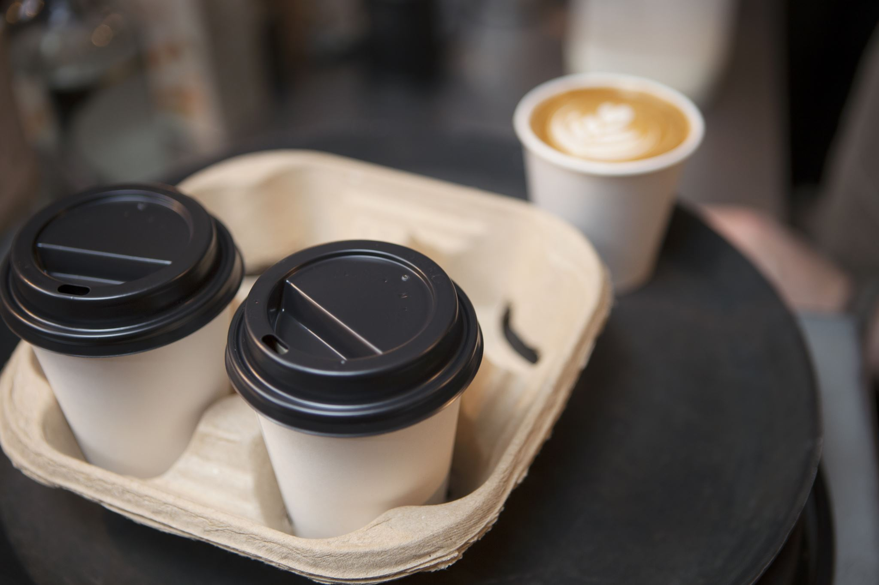

Project Stage 3 Team J
CPSC 481 – Fall 2020
TA: Hessam Djavaherpour
Minh Hang Chu, Edward Mah, Yunfan Yang, Nicolas Urrego

Slide 2








Project Idea
Reserving and Food Ordering Mobile Application
Sign in as a guest or have an account
Select date, time, number of people, and seat preference
View a list of restaurants grouped by types
View restaurants information
Preview restaurants menus before reserving
Pre-order food items and invite other people to a reservation
Leave reviews for a restaurant

Slide 3
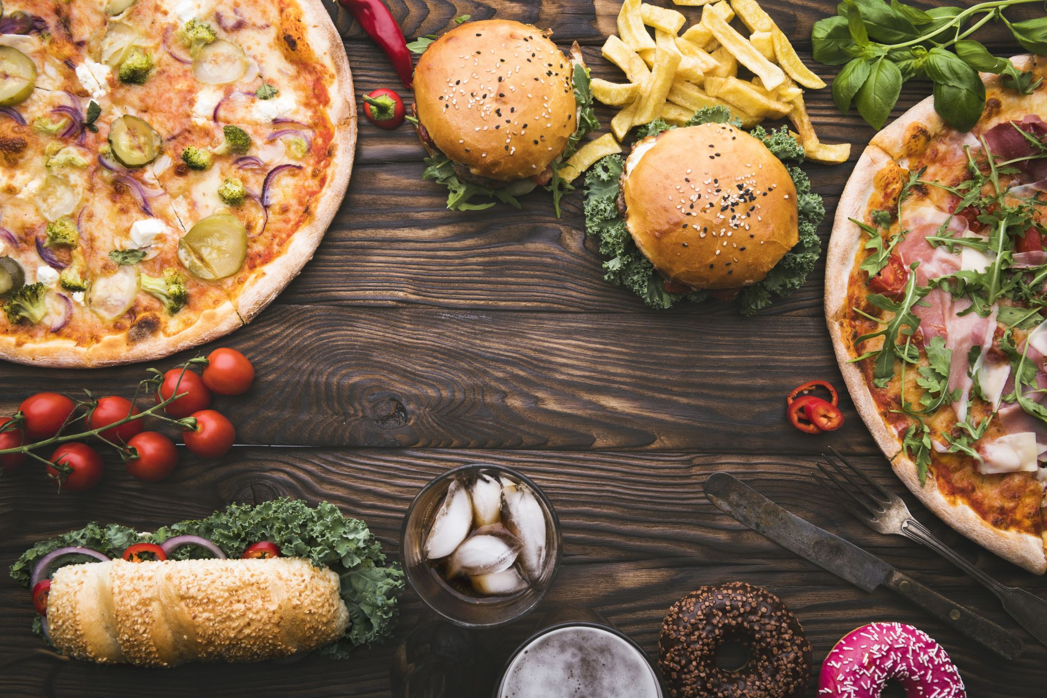
DEMO

Slide 4
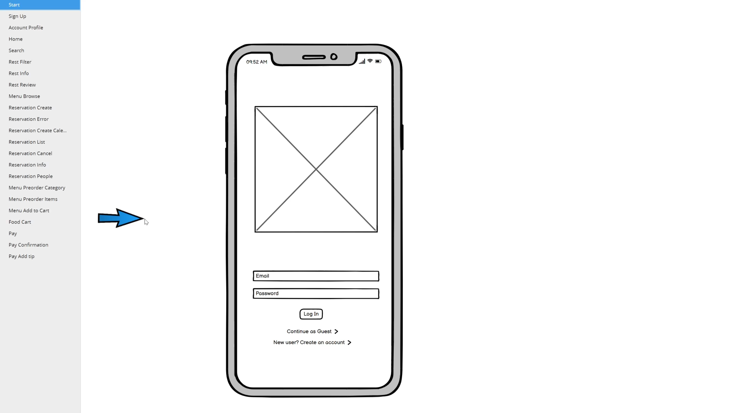

Slide 5
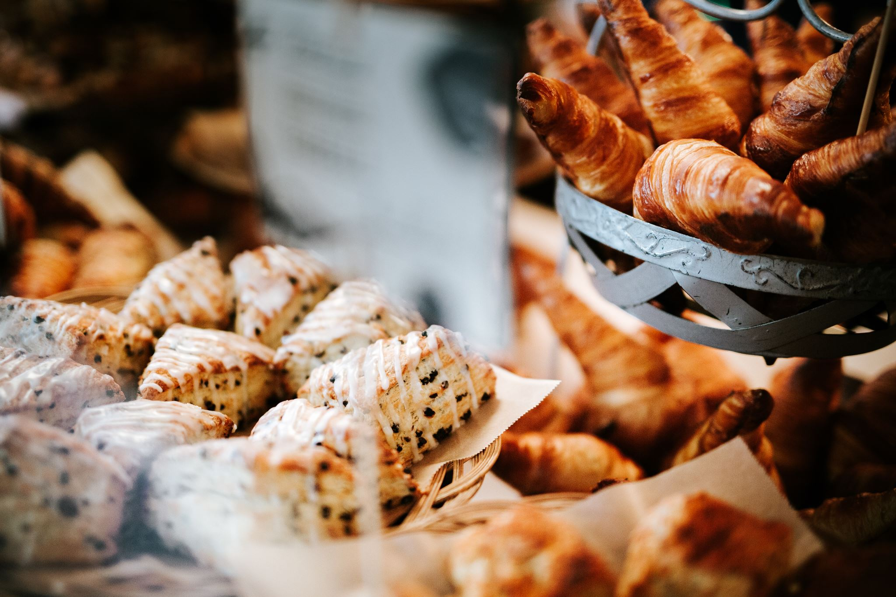
OUR JOURNEY

Slide 6
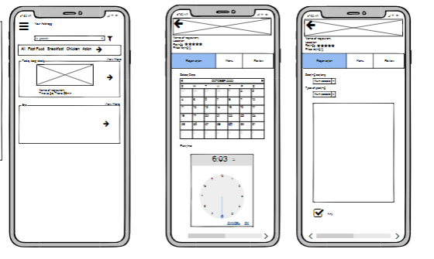
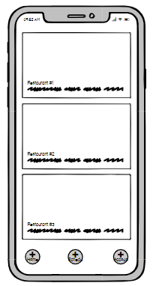
Refining Ideas
Brainstorm
Affinity diagram
Select & polish ideas
Low-fidelity prototype
Final idea

Slide 7
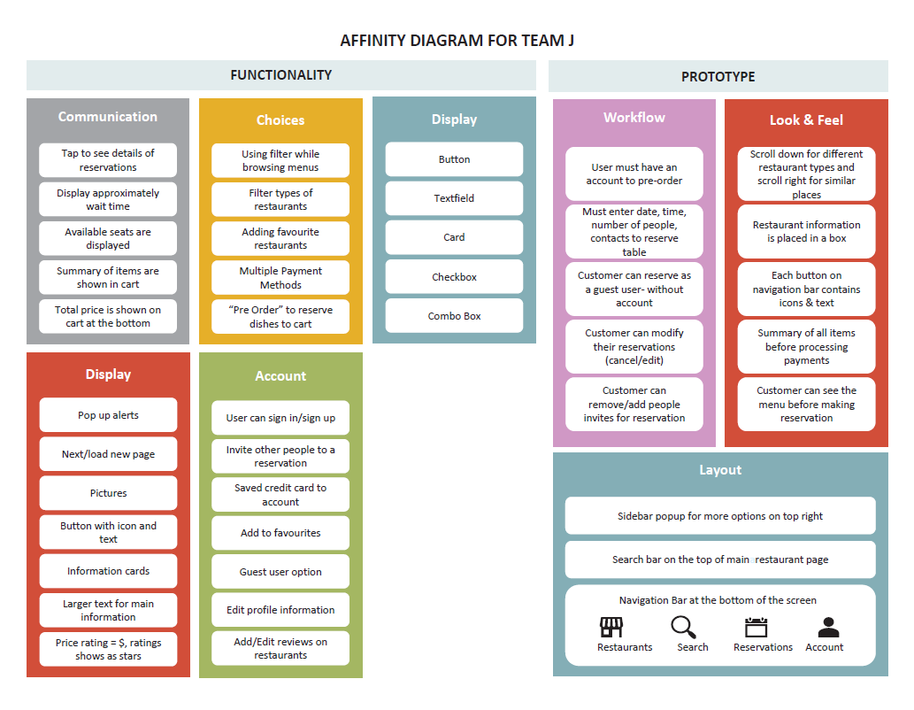
Affinity Diagram

Slide 8
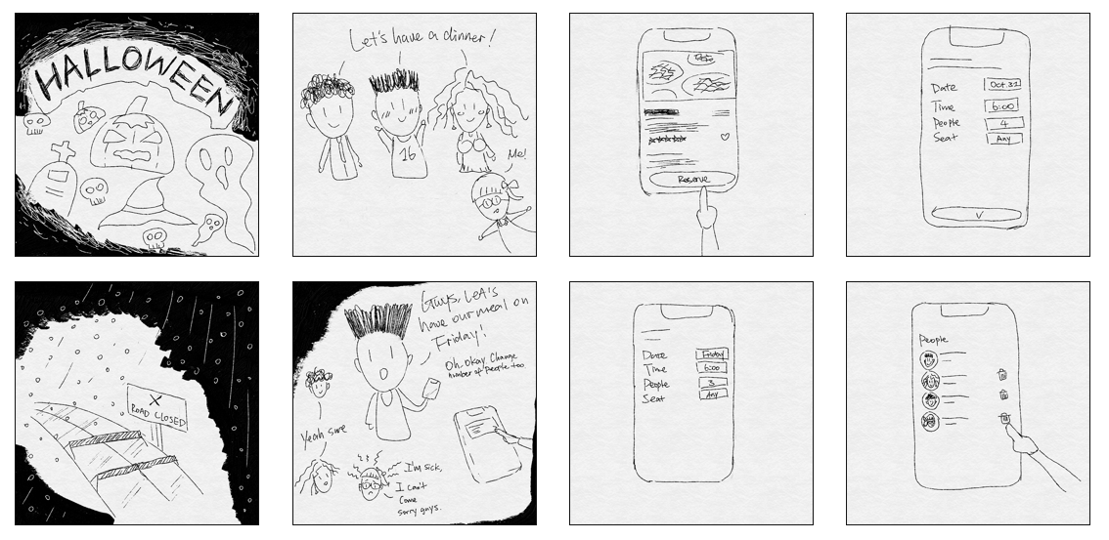
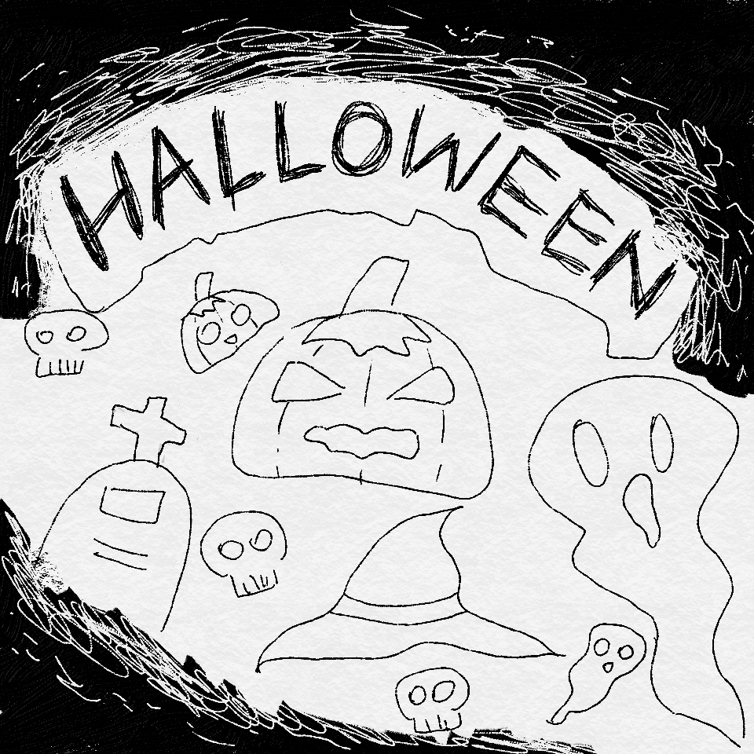
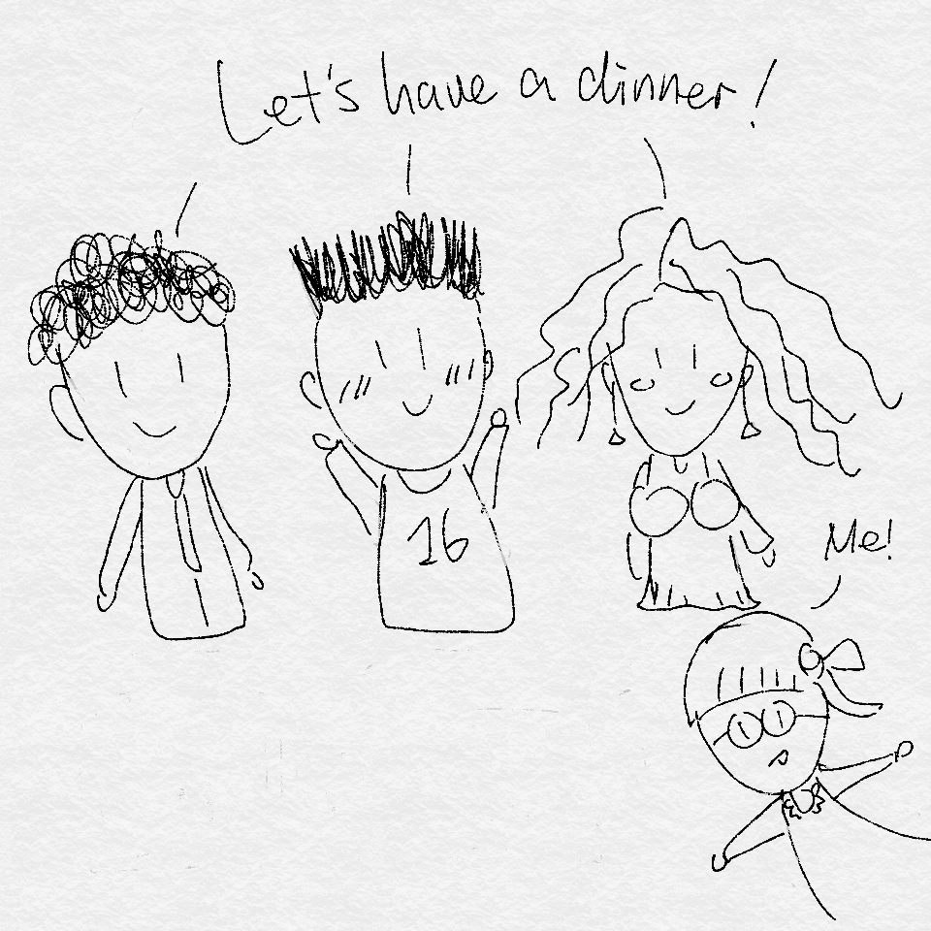
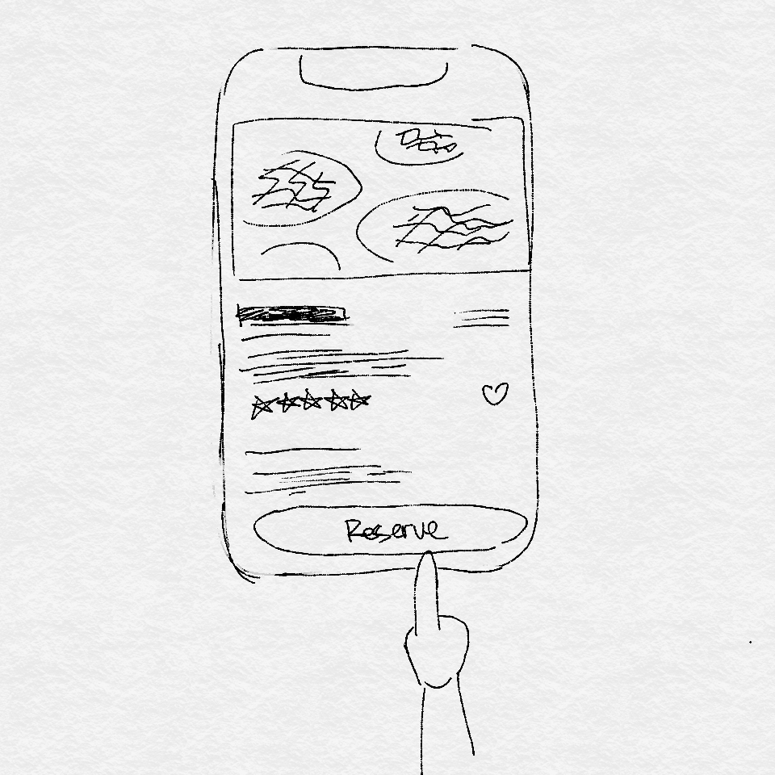
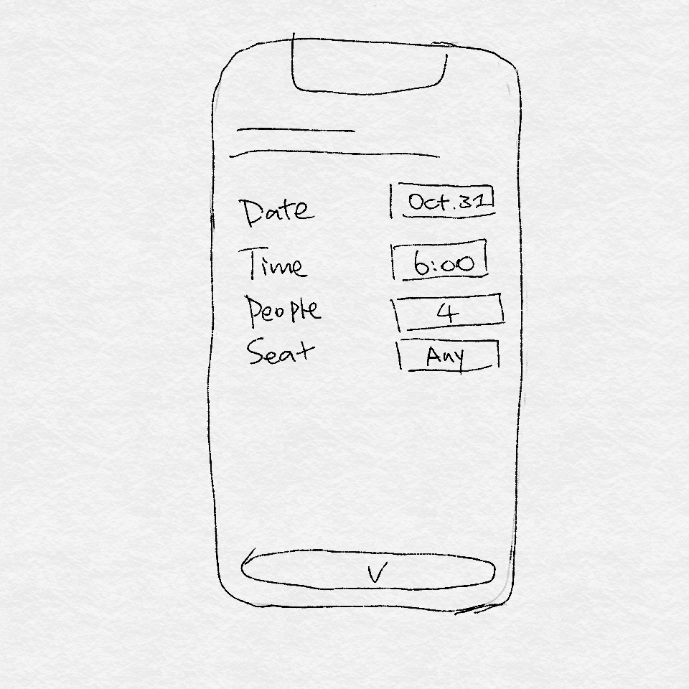
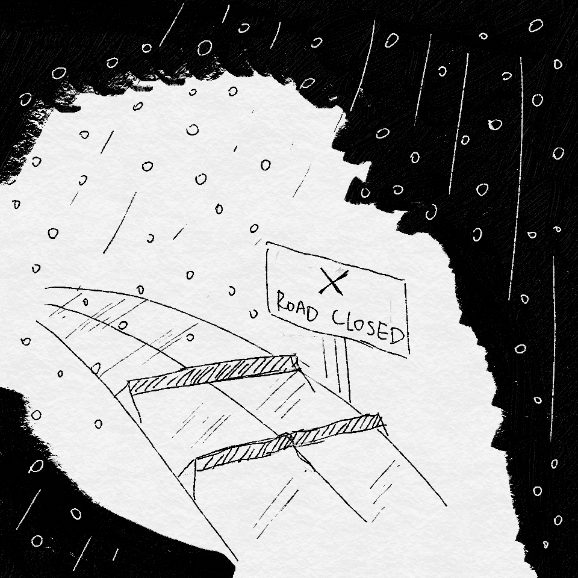
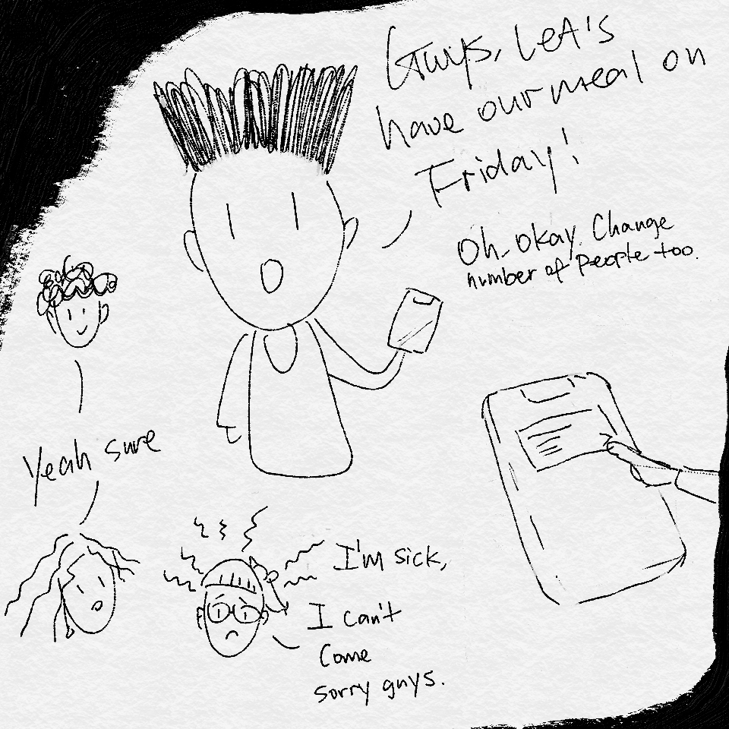
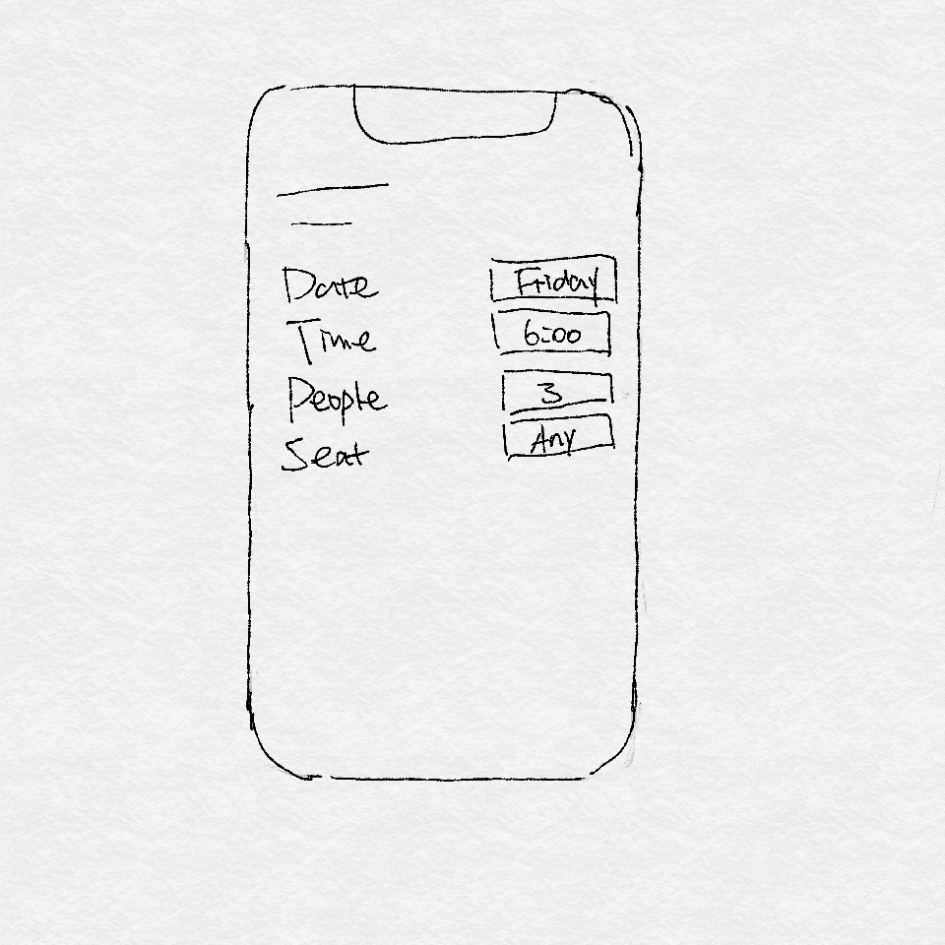
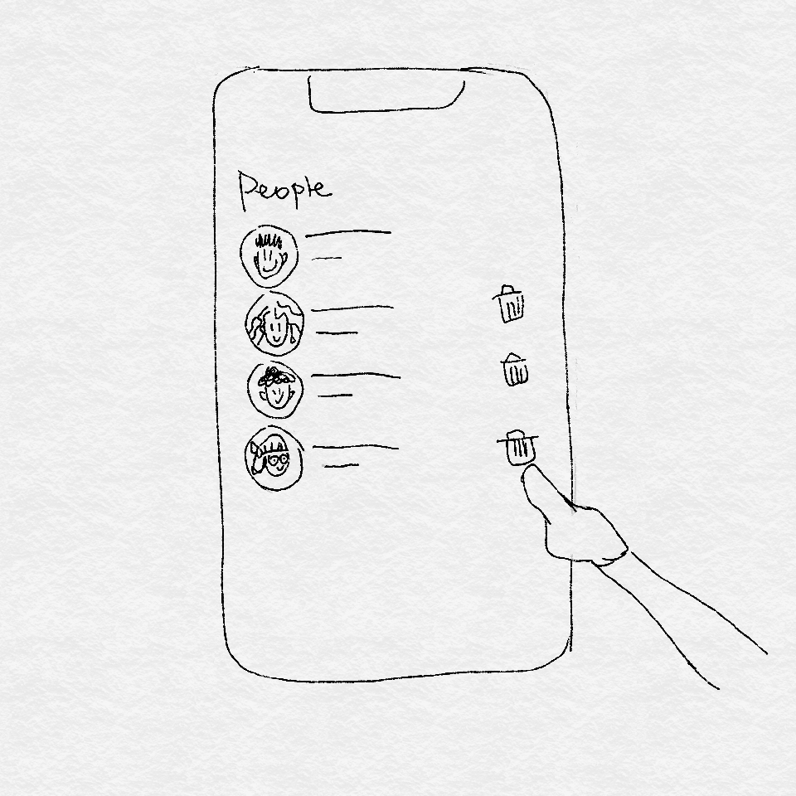
Storyboard

Slide 9
Lesson Learned
Building up an UI prototype from rough sketches
Refining the organization of the application
Understanding how to implement the must-be-included tasks

Slide 10





Cognitive evaluation
Making pages instead of popups
Removing navigation bar from all pages
Implementing icons as much as possible
Removed the host

Slide 11
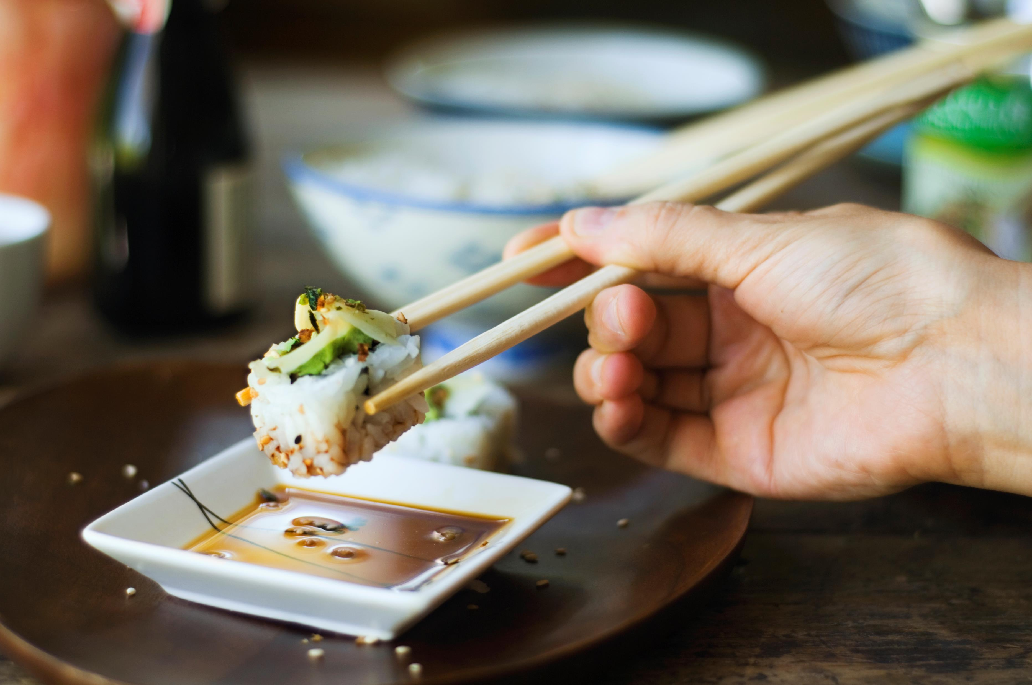
THANKS FOR WATCHING!

